Slide 1



Slide 2

MERN Stack
MongoDB: MongoDB Atlas allows the use of cloud services.
Express.js: Web application framework. Combines with Node JS to form backend.
React.js: Frontend(user interface).
Node.js: JavaScript environment for server side.

Slide 3
Packages Used
“npm install express”
“create-react-app”
“npm install jsonwebtoken”
“npm install dotenv”
“bcrypt”
“npm install mongoose”
“CORS(Cross-Origin Resource Sharing)”
“CRACO”

Slide 4
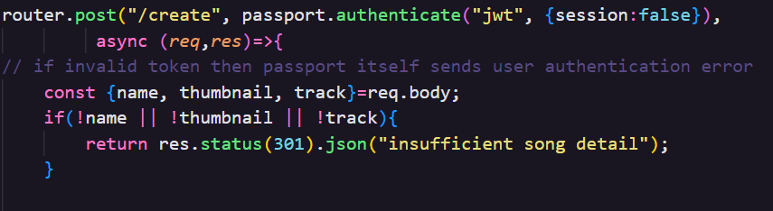
Express.js
“const router =
express.Router();”
We are using Express
package to create a new
Router that will handle requests.
“req.body” is used to access data at client side.
“passport.authenticate("jwt", { session: false })”
A JSON web token(JWT): is used to securely transfer information between parties as a JSON Object.

Slide 5
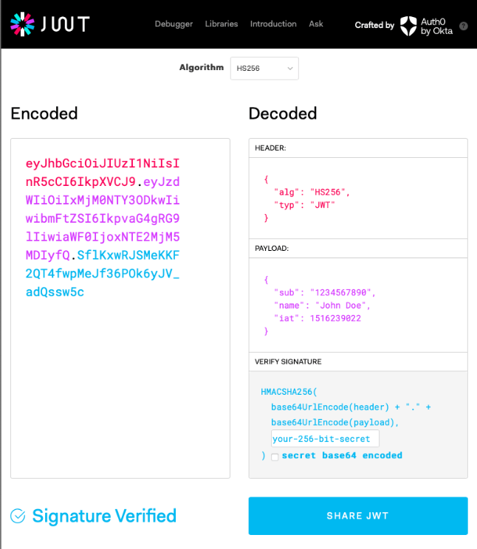
JWT Authentication feature
JSON Web Tokens have been used for securely transmitting information between parties. Because JWTs is be signed. Since the signature is calculated using the header and the payload, we can also verify that the contents have not been tampered with.
“ExtractJwt.fromAuthHeaderAsBearerToken();”
Bearer Tokens are used for this application. These are meaningless strings not intended for use by clients.

Slide 6
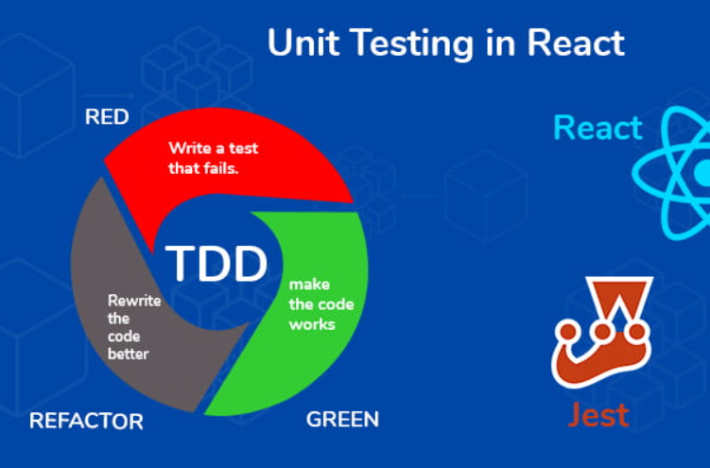
React.js
Create-react-app(CLI command) is used for basic react setup. This saved a lot of time on setup and complex configurations.
“if (env.raw.FAST_REFRESH && semver.lt(react.version, '16.10.0'))”
Fast Refresh: This react feature is used for instant visibility of any edits made.

Slide 7
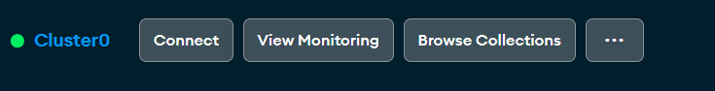
MongoDB Atlas
MongoDB provides flexibility in storing and retrieving diverse data related to songs, playlists, and user profiles.
Using MongoDB Atlas is useful when programmer wants to utilize cloud services.
Simplifies deploying the database on cloud.
Provides us with several integrated tools.

Slide 8
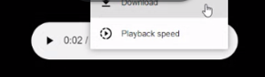
Features
1. USERS:
SignUp( new user)
LogIn ( existing user)
Log Out
2. SONGS:
Upload song (user is an artist too)
Download songs
Shuffle songs from an artist library

Slide 9
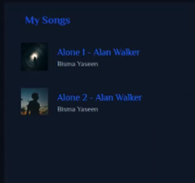
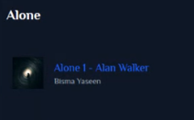
Features
Repeat song
Fast forward (increase speed by 0.25x)
Rewind (decrease speed by 0.25x)
Like songs
Pause and resume
Play next song
Play previous song
Volume increase and decrease
Progress bar (fixed)
.

Slide 10
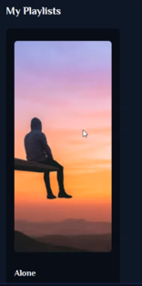
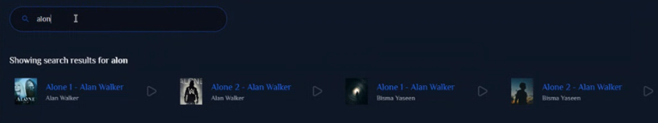
More Features
Searching :
- search by songName
- dynamic searching (regex)
3. PLAYLIST
Create Playlist
Add song to playlist
View and play songs in playlist

Slide 11
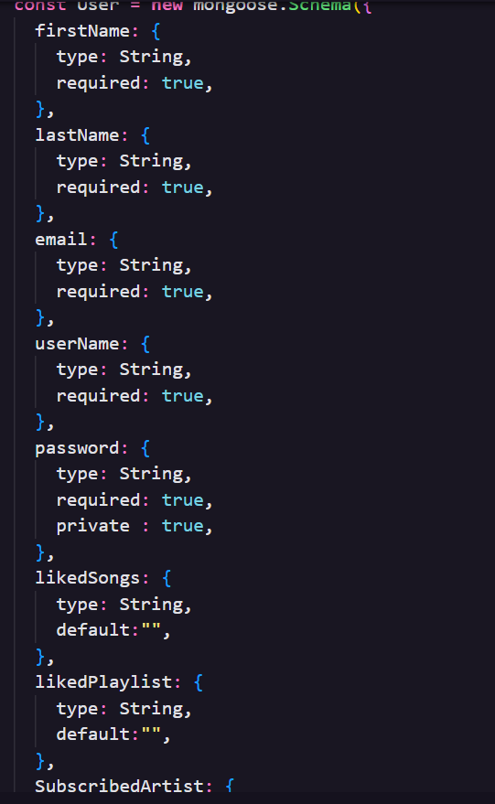
MongoDB models
User:

Slide 12
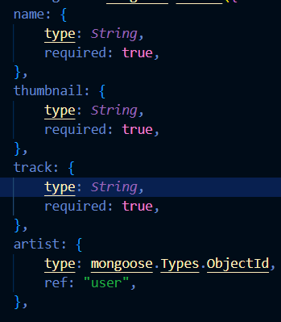
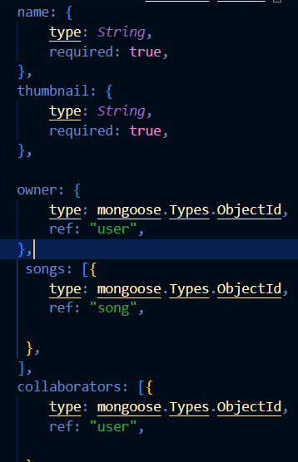
MongoDB models
Song:
Playlist:

Slide 13
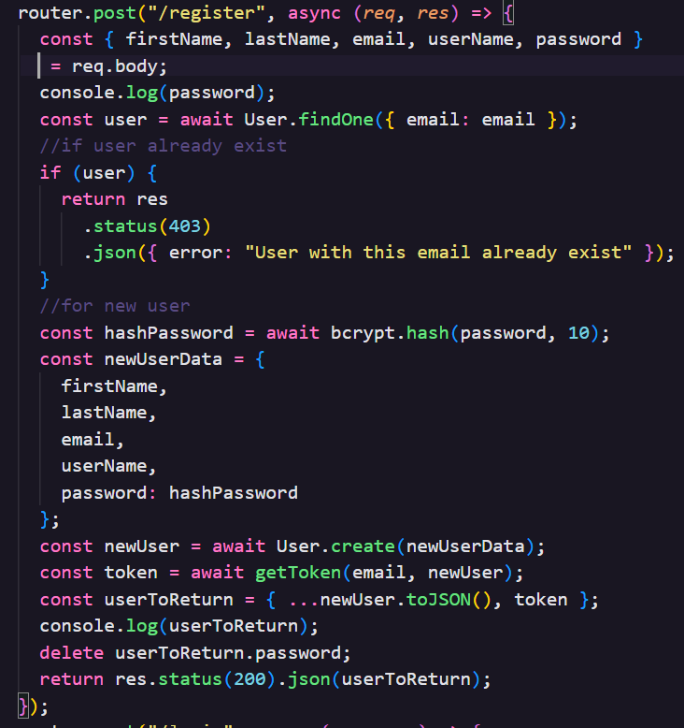
API
User API:
User register
User Authorization.
Song
Create new song
Get my songs
Get All songs by Artisit ID
Get Songs by song name

Slide 14
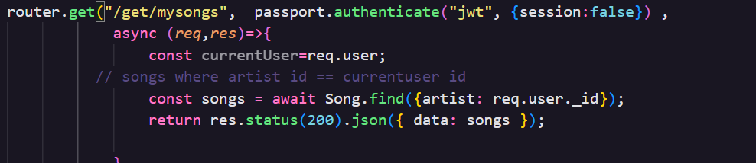
API
PlayList
Create playlist
Add songs to playlist.
Get Playlist by ID
Get play list by artist iD
Get all Songs in Playlist

Slide 15
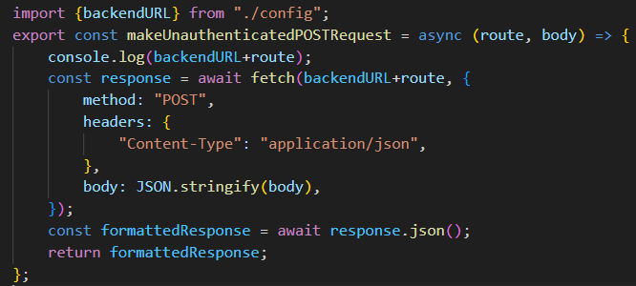
Connecting Backend with Frontend
URL for backend has been defined in config.js file.

Slide 16
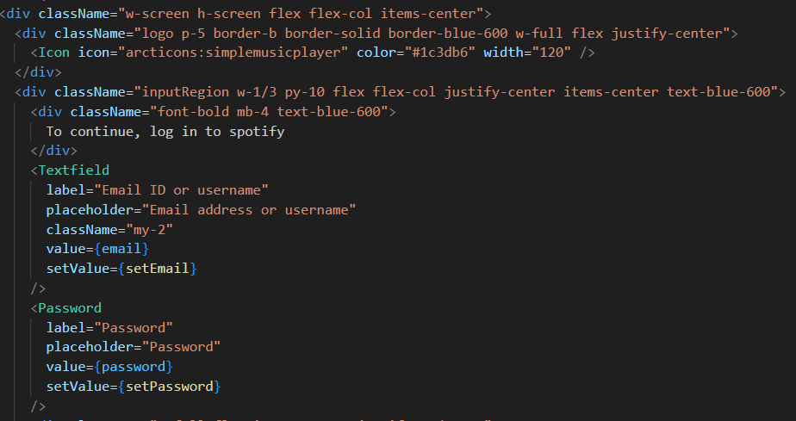
Tailwind CSS Login Page styling example

Slide 17
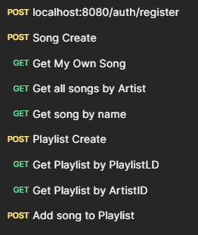
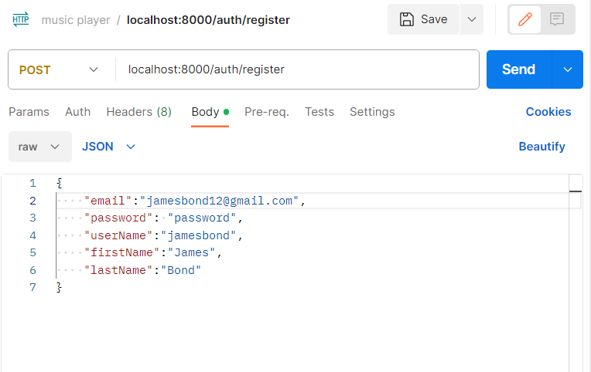
Testing
Register User:

Slide 18
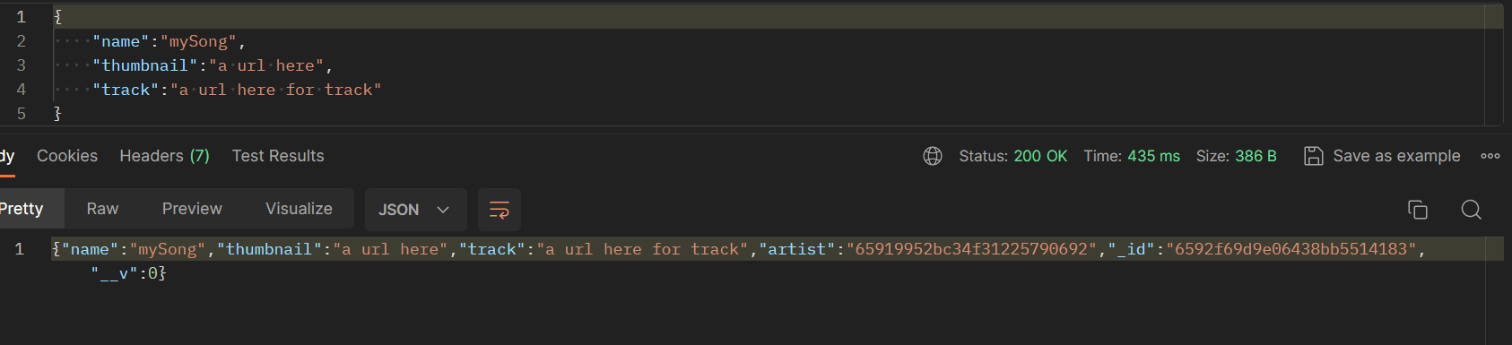
Testing
Create Songs:
In create songs API, the creator should be an authentic user. So the Bearer token used here was taken from registered users API. Otherwise API should and will not work.
(authentic user creates song)

Slide 19
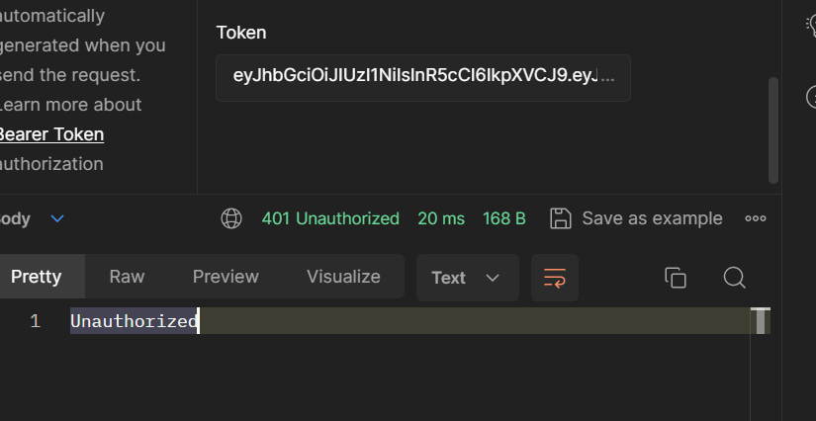
Testing
In create songs API, the creator should be an authentic user. So the Bearer token used here was taken from registered users API. Otherwise API should and will not work.
“passport.authenticate("jwt", { session: false })”:
it is ensured that every request received is from an authentic user.

Slide 20
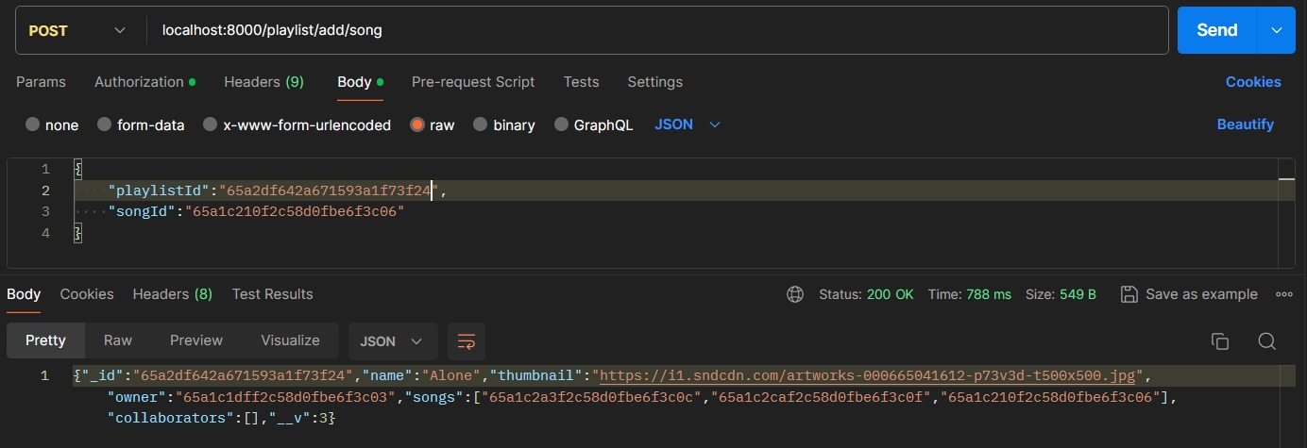
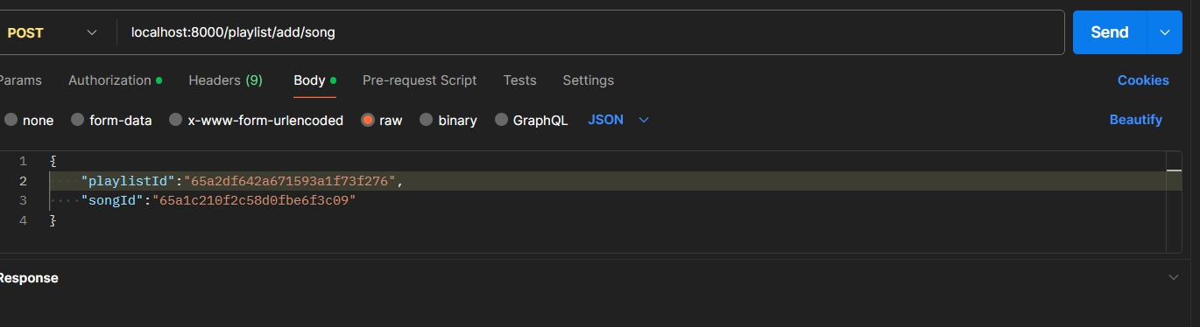
Testing
Add Song to Playlist:
Successful Test
Failed Test

Slide 21
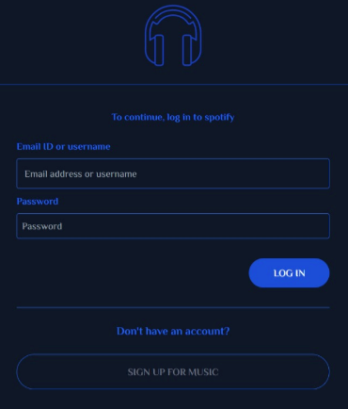
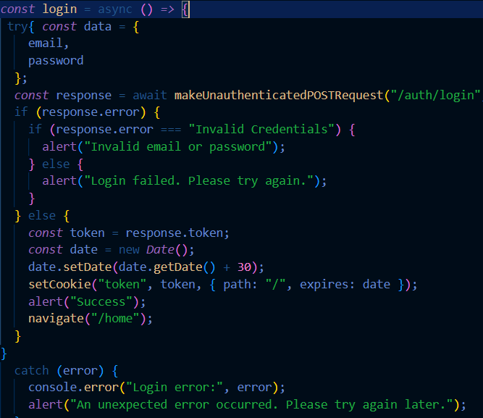
Frontend
Logging in

Slide 22
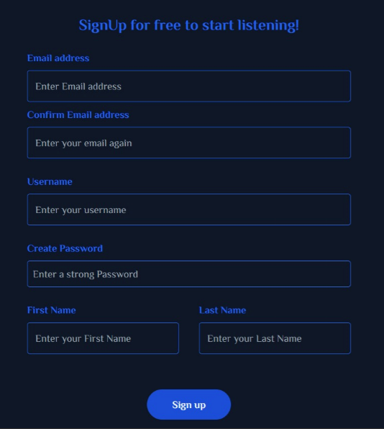
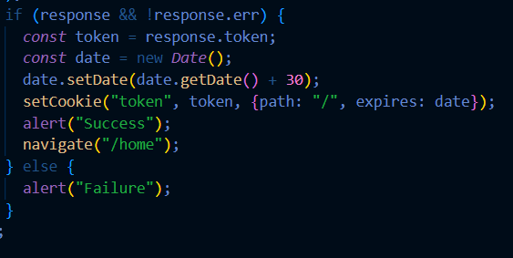
Frontend
Signing up

Slide 23
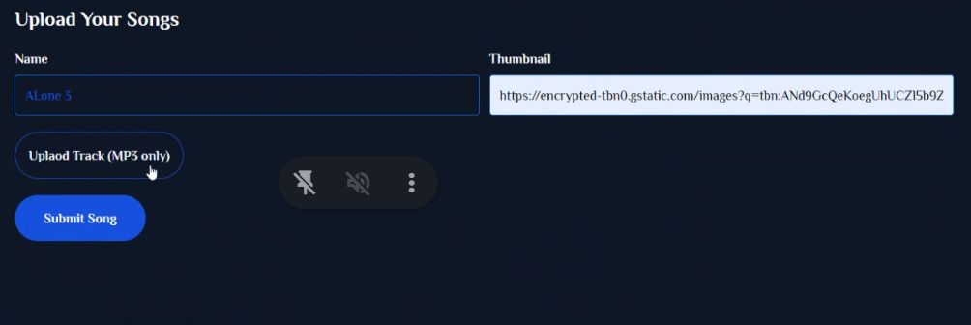
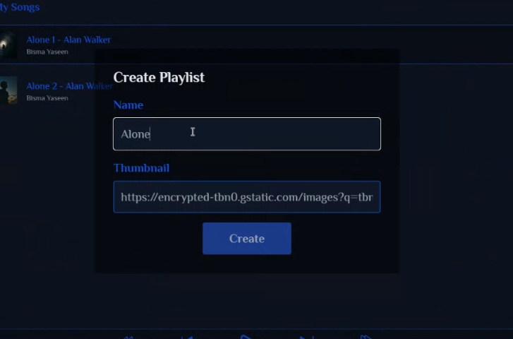
Frontend
Create Song Instance
Create Playlist:

Slide 24

Frontend
“import {Cloudinary as CoreCloudinary, Util} from "cloudinary-core";”
Manipulating song files via Cloudinary:
Using Cloudinary allows easy uploading of songs to the cloud and automate smart manipulations of media without installing any other software.
183 companies reportedly use Cloudinary in their tech stacks, including Facebook and LinkedIn.

Slide 25
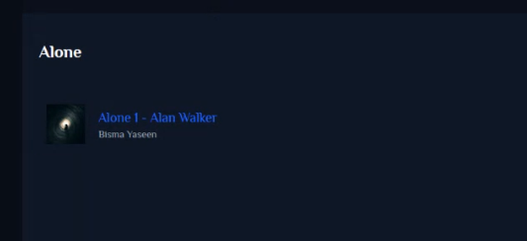
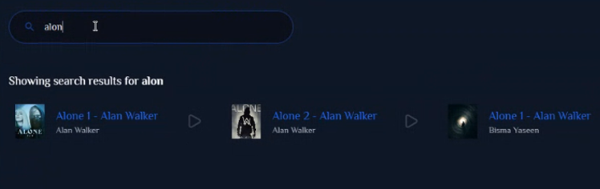
Frontend
Add Song to Playlist:
Searching songs:

Slide 26
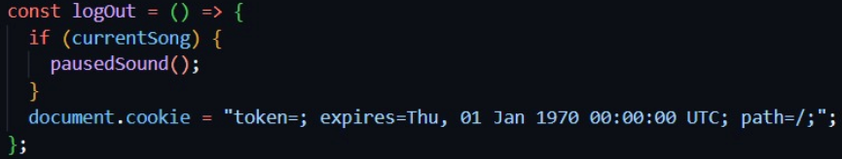
Frontend
Log out:
Log out button function:

Slide 27
Challenges
“bcrypt.hash(password, 10);”
“bcrypt.compare(password, user.password);”
user passwords are supposed to be confidential, even from the
owner of the database. For security reasons the passwords are
hashed and hidden from all audiences. But the programmer had to
compare the two passwords when checking if the user is already registered(by comparing entered password with passwords in DB). This challenge was tackled using
“bcrypt” package function compare().

Slide 28
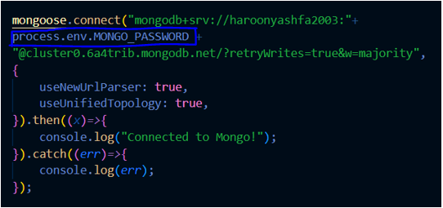
Challenges
MongoDB password visibility(in the connecting string)was not an issue unless we are asked to demonstrate the code. This issue was resolved by creating a separate environment variable file and storing our password in it. This trick has also been useful when uploading this project on GitHub. The “.env” file is not required by anyone since it contains our passwords.

Slide 29
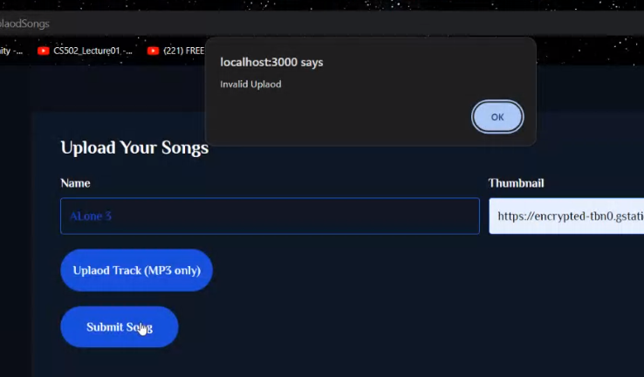
Challenges
The app also accepts MP4 files. MP4 files can also be stored in our database. However does not play a video along with audio. This issue was also resolved.

Slide 30
Enhancing Features
A separate and relevant interface for artists.
Implementing collaborators in a playlist on a large scale.
Adjusting Bass and Treble features.
Sharing songs with friends.

Slide 31

ThankYou
Any Question?

